Slide 1
Meme Analysis And Classification
Dharmin Shah (dharminu@usc.edu)
Naiya Shah (naiyahim@usc.edu)

Slide 2
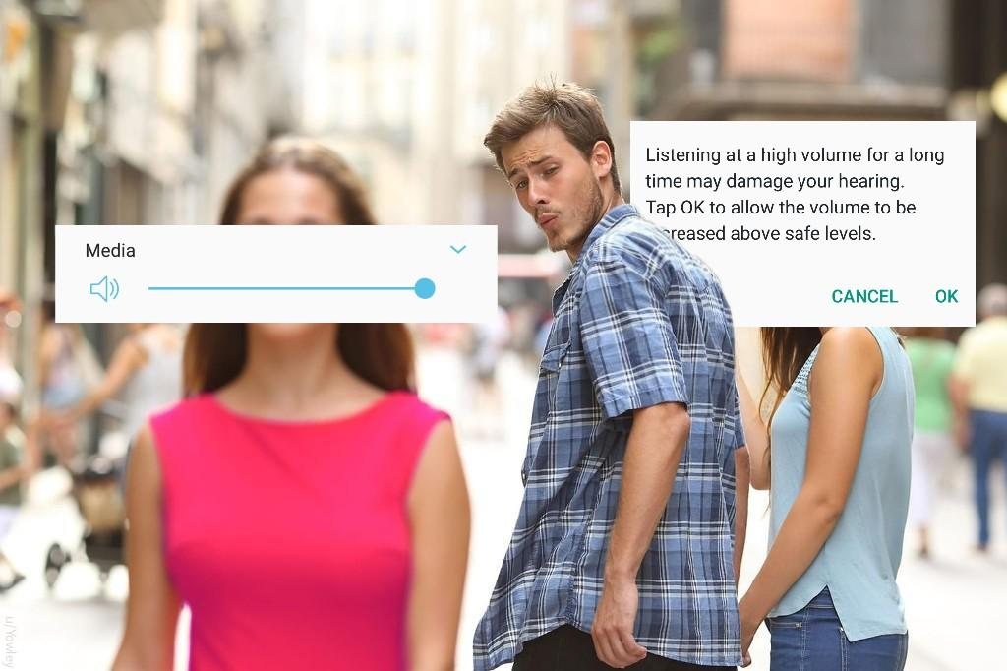
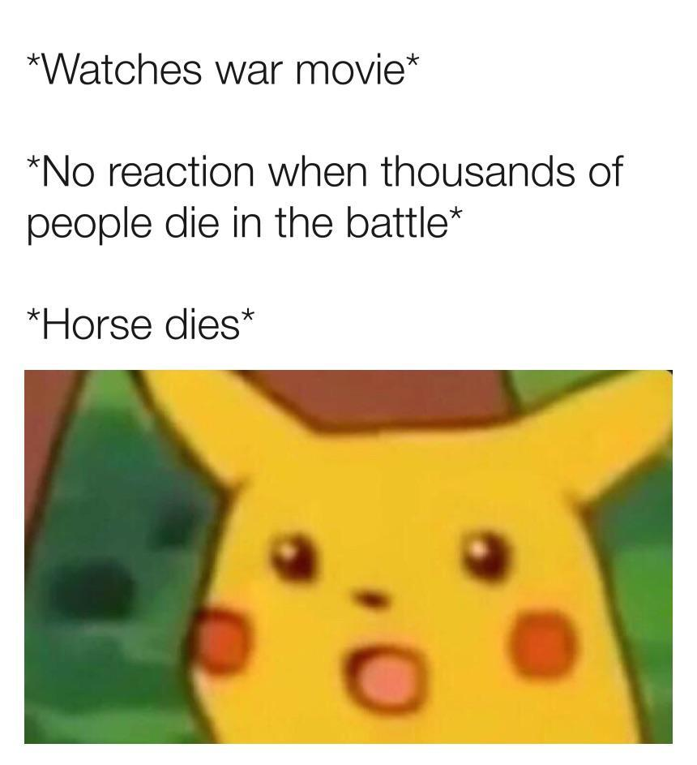

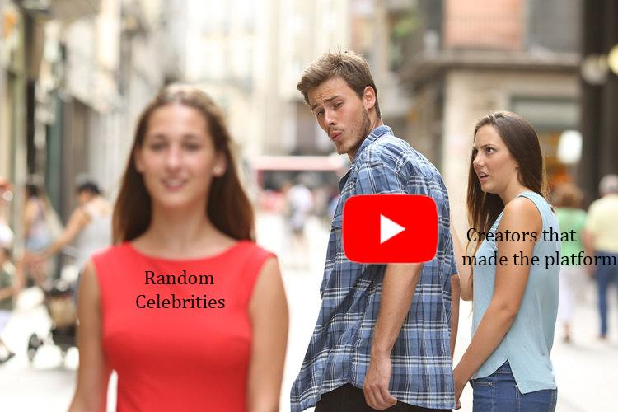

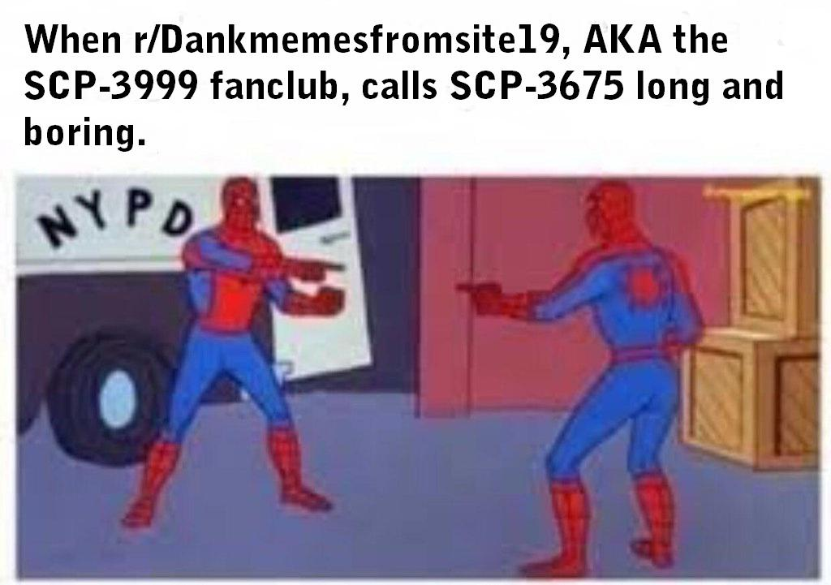

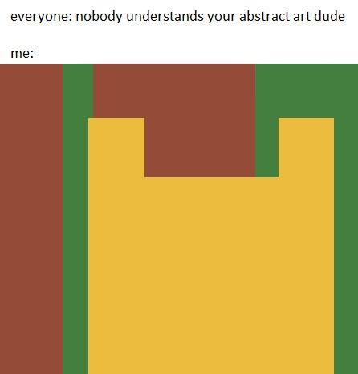

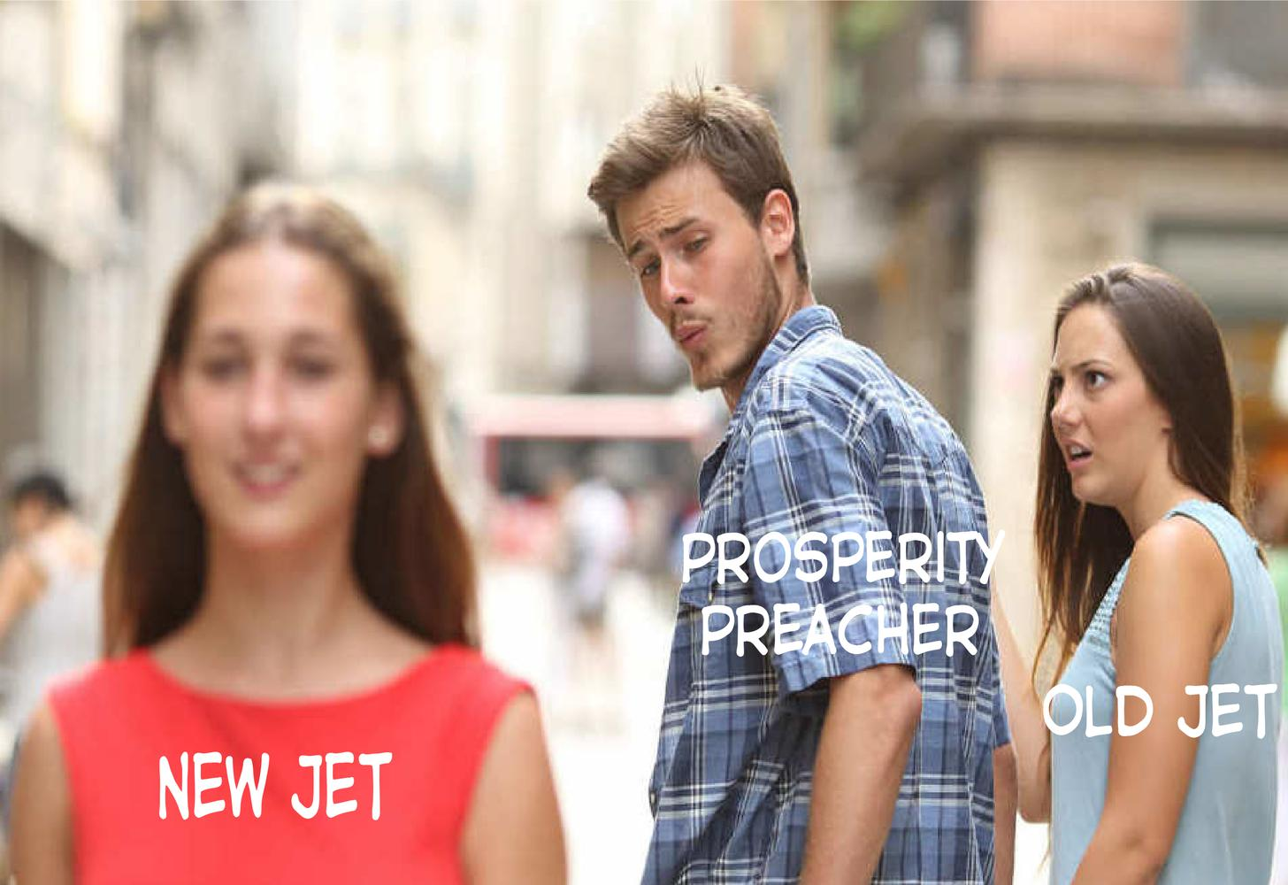

RESEARCH PROBLEM
Analysing meme data to classify memes into categories by identifying important features.
Class 1
Class 2
Class 3

Slide 3
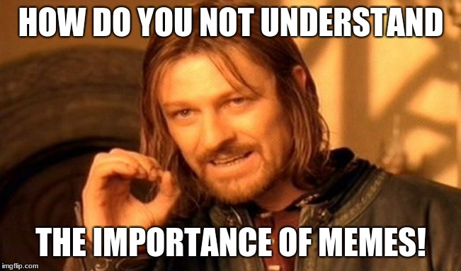








Motivation
Internet memes have revolutionized the way we incorporate humor into communication over the recent years
Music
Articles/News
Movies
Memes
Entertainment Sources

Slide 4
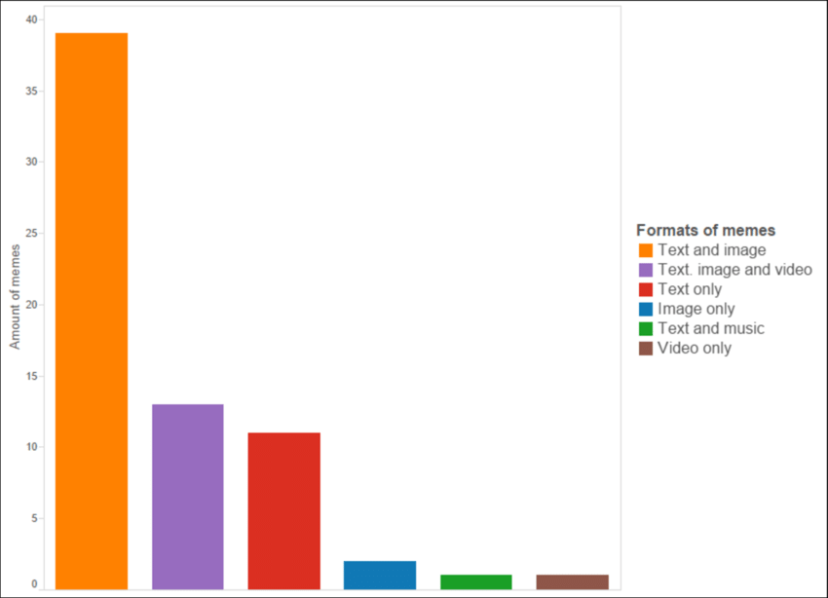
HIGH LEVEL APPROACH
CLASSIFICATION
Text (Content)
Image (Template)

Slide 5
DATA
Web Scraping
Sub reddit memes- content based memes
Meme generator- template based memes
Train/ Test data Ratio: 80:20
awkward_moment_sealion | 50
bad_luck_brian | 50
distracted_boyfriend | 50
hackerman | 50
hackerman | 50
pikachu_o | 50
Student life | 200
COVID-19 | 200
Depression | 200
Climate | 200
Election | 200
TV Show | 200
Templates and count
Content and count

Slide 6
METHOD
Step1. Classification Based on Template (Visual Data)
Radial Colour Histogram of the image.
Color + Composition
Information
Convert
RGB To HSV
Log transformation of pixel counts to help focus on the little differences
TESTING
Predicts
Meme Template Labels
Accuracy = 0.97
TRAINING
SVM(Features, Labels)
Linear Support Vector Machine
8 bins per channel (instead of 3)
2048 features (instead of 108)

Slide 7
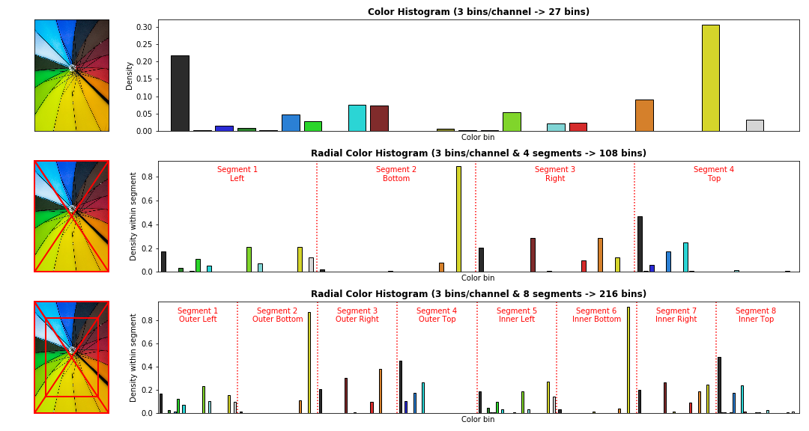
8 ^ 3 ⇒ 512 bins per segment (8 bins per channel)
8 segments * 512 = 4096

Slide 8

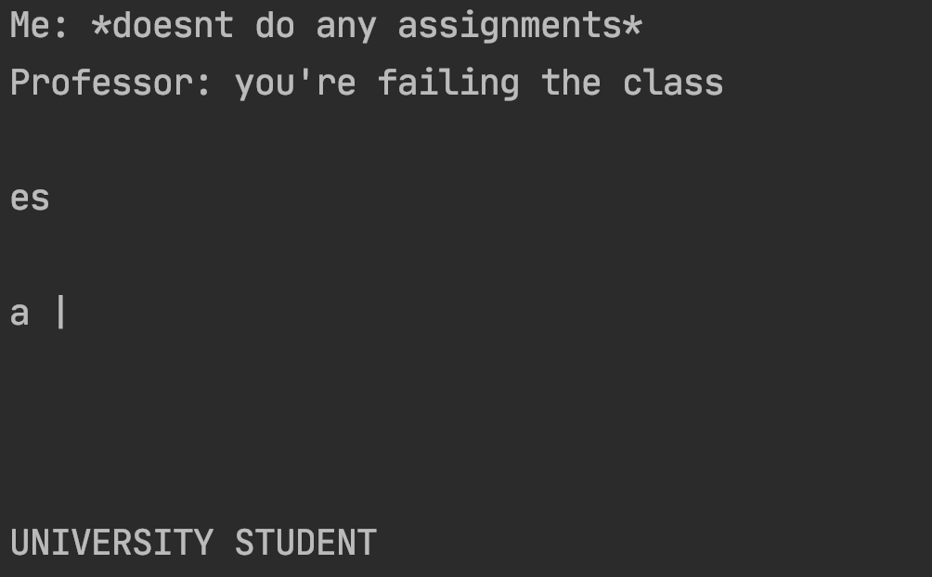
METHOD
Step 2. Classification Based on the Content (Textual Data)
Run Optical Character Recognition on the image to extract text
Output from Tesseract OCR:

Slide 9
METHOD
Clean the input:
Remove extra/ non alphabetic characters
Keep only valid english characters
Stopwords removal
[Me doesnt do any assignment Professor youre failing the class]
Merge all text data from the same classes
Extract text features
Compute TF-IDF feature vector for train and test data
Feed input to Supervised Machine Learning Algorithm- Naive Bayes
Predict class of the testing data
ACCURACY: 0.87

Slide 10

METHOD
Classify on the basis of both Content and Template :
[Meme_Template_Label, Content_Label]
[Surpised_pickachu, Student_Life]
Accuracy of combined features : 0.85

Slide 11
Results
Accuracy metric= Correctly predicted class/ Total Input
Template based classification
Accuracy = 0.97
Text based classification
Accuracy = 0.87
Combined classification accuracy
Accuracy = 0.85

Slide 12

Insights And Limitations
Not every meme will follow a Fixed Template.
In such cases it is important to understand the sentiment conveyed by the image and not just composition information.
LABEL = Stress or Depression
Cannot predict upvotes on the basis of just meme features, need user related data as well.

Slide 13
Insights And Limitations
Structure of memes- positions and color of image and text are fixed for each template. Hence, composition information can be used to classify memes on the basis of template.
There are common words used within a fixed template as well which can be used to classify memes into different templates.
Contextual Information of the sentences used in the meme using word2vec or BERT might be helpful to predict the sentiment of the meme along with the visual understanding of image using CNN.

Slide 14
Future Work
Extract emotion of the meme- humour, sarcasm, offensive, and motivational.
Try to predict upvotes by using both social network information related to users as well as these features of meme. (Content Based recommendation)
Use Convolutional Neural Network :
Classify memes based on the context depicted by visuals of the image
Improve OCR output to avoid partial text retrieval problems

Slide 15
Thank you

